Slide 1
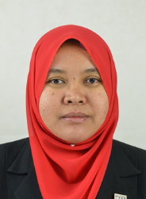
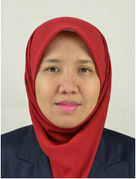
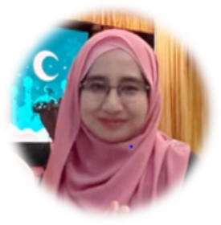
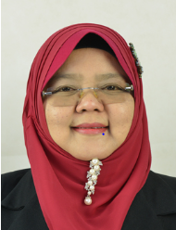
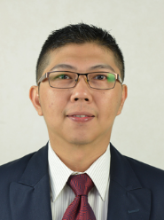
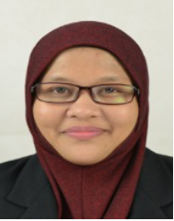
BCT Industry Coordinator
WBL PUO ORGANIZATION CHART
2022
PEMBINAAN TETAP TEGUH SDN BHD
PIC: Pn. Siti Hawa
GAMUDA BERHAD
PIC: Ms Ng Bon Chin
CLCE CONSTRUCTION SDN BHD
PIC: Chong Chee Leong
MNH ENGINEERS SDN BHD
PIC: Ms Salwa
ORANGEBEAM BERHAD
PIC: Ms. Aisatul Attena
SUNWAY CONSTRUCTION SDN BHD
PIC: Ms. Natalie Yaw
TRANS RESOURCES CORPORATION SDN BHD
PIC: Pn.Aishah Pata
SAMSUNG C&T (KL) SDN BHD
PIC: Ms. Azlina Ariffin
SYARIKAT PEMBENAAN YEOH TIONG LAY SDN BHD
PIC: Ms. Ching Lai Deng
Pn Mazziyatol Farizza binti Mat
BCT WBL Coordinator
Ts Dr Azuin binti Ramli
BCT Program Leader
Ts Dr Izwah binti Ismail
PUO Deputy Director Academic
BMS Industry Coordinator
Pn Samikhah binti Muhammad @ Munir
PUO WBL Coordinator
BMS Industry Coordinator
BRAHIM’S SATS FOOD SERVICES SDN BHD
Pic: Cik Normalizawati Binti Mohd Razali
DINDINGS POULTRY PROCESSING DN. BHD
Pic: Cik Solehah
HASRAT MERANTI (CHEMOR) SDN BHD
Pic: Ms Goh Swe Nee
HOVID BERHAD, CHEMOR,
Pic: Chin Siat Thee
KPNK AUTOMOTIVE INDUSTRIES SDN BHD
Pic: Pn Maslina Binti Kassim
MICRON MEMORY MALAYSIA SDN BHD
Pic: Pn. Suhaila Majid
OHR MARKETING SDN BHD
Pic: Hanisah Binti Mohd Dahri
POWER CABLES MALAYSIA SDN BHD
Pic: Pn. Norfatimah Binti Yahya
SIPRO PLASTIC INDUSTRIES SDN BHD,
Pic: Mohd Saiful Bin Abd Rahman
WSA VENTURE (AUSTRALIA) SDN BHD
Pic: Pn. Norra Binti Abdullah
ZENIG AUTO SDN BHD
Pic: Pn Hamidah Binti Khalil
Ts Dr Woo Tze Keong
BMS Program Leader
Pn Azmanrini binti Ahmad Nadzri
BMS WBL Coordinator

